Slide 1

PHYSICAL EDUCATION
2019-2020

Slide 2

MEET THE STAFF

Slide 3
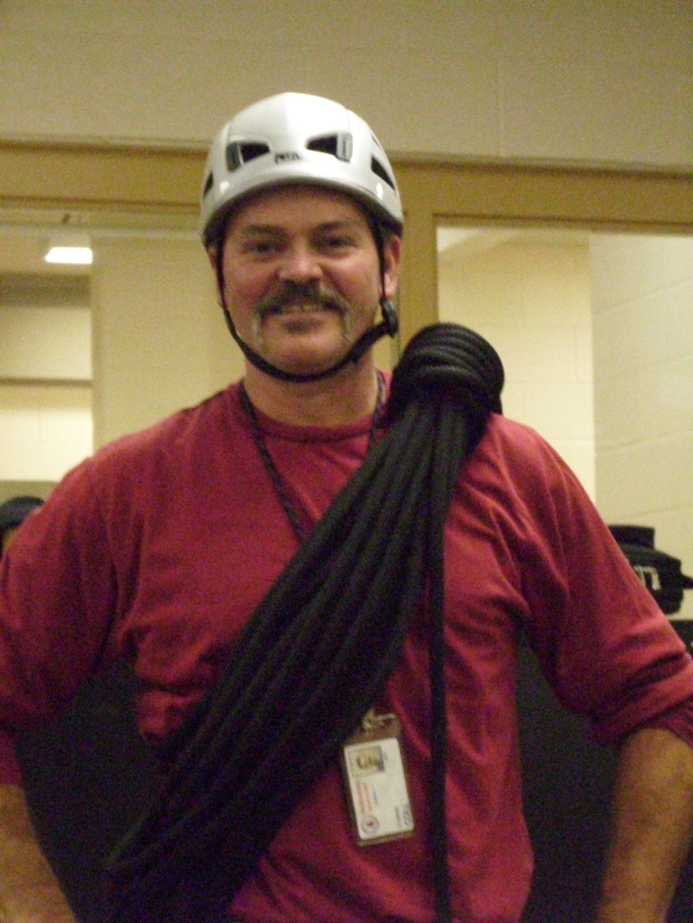
MR. COLL

Slide 4

MRS. GERUC

Slide 5

MS. JOHNSON

Slide 6
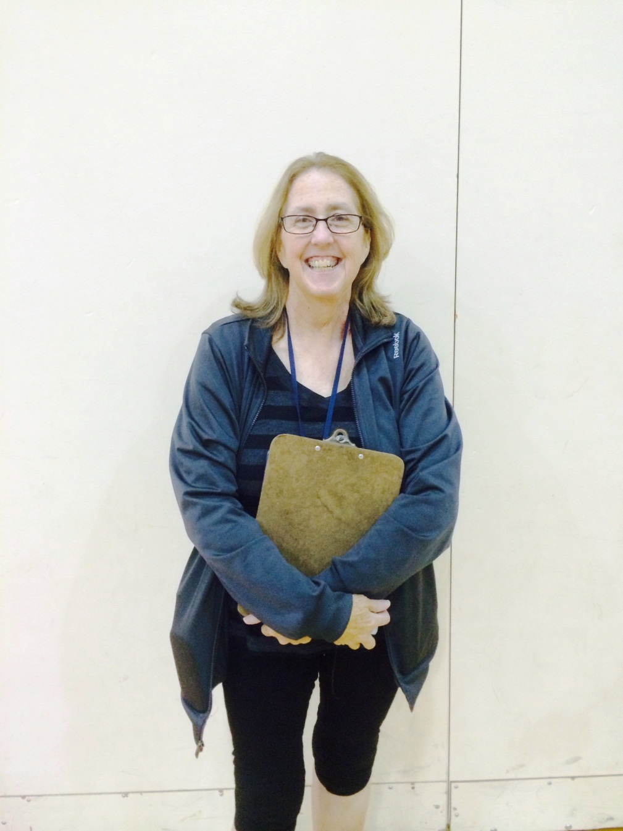
MRS. KING

Slide 7
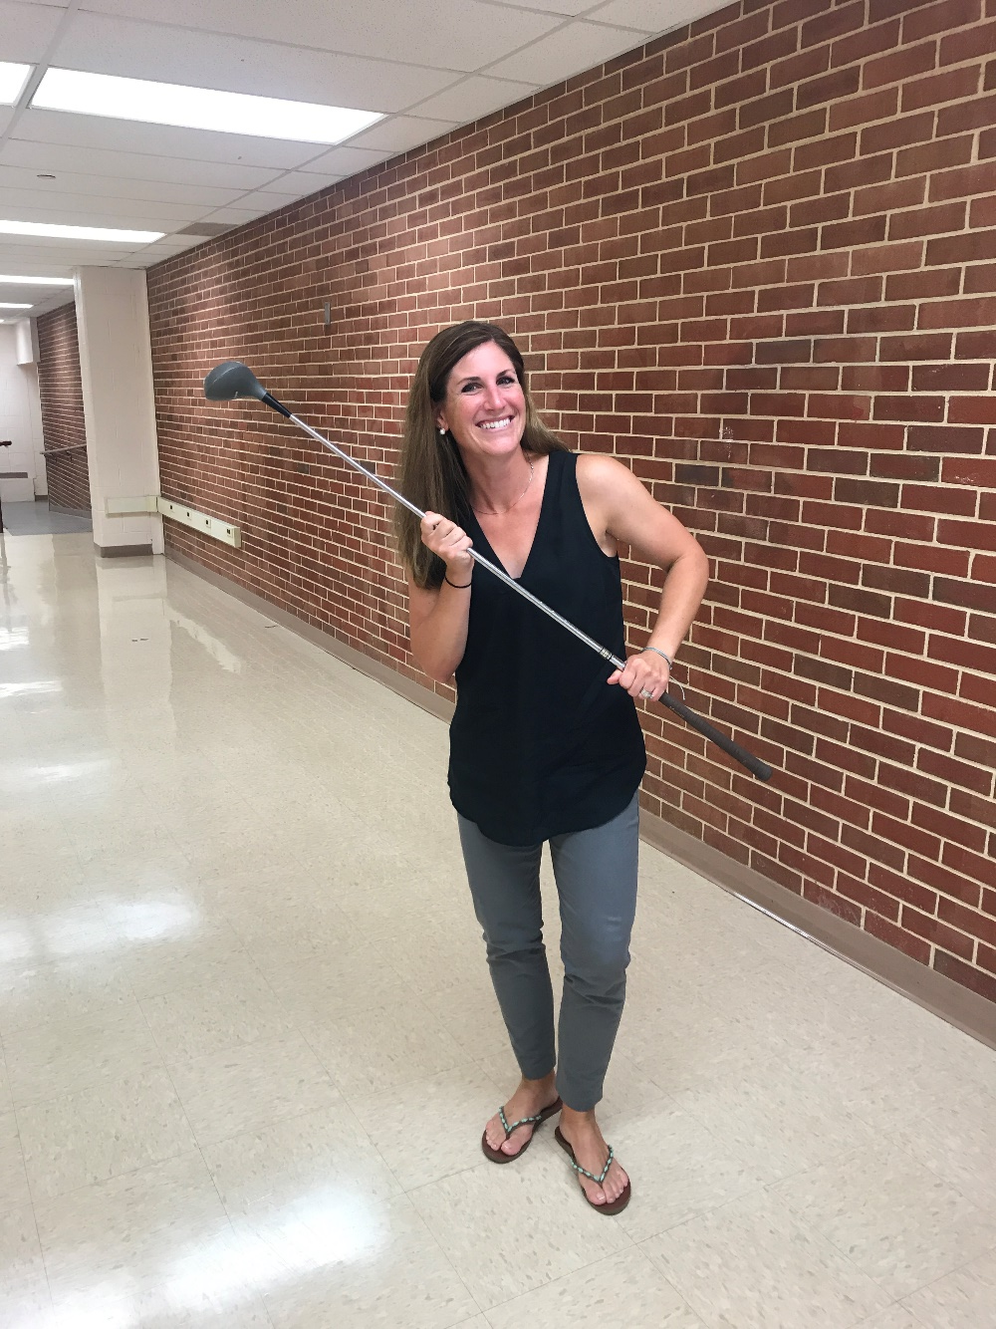
MRS. PINTO

Slide 8
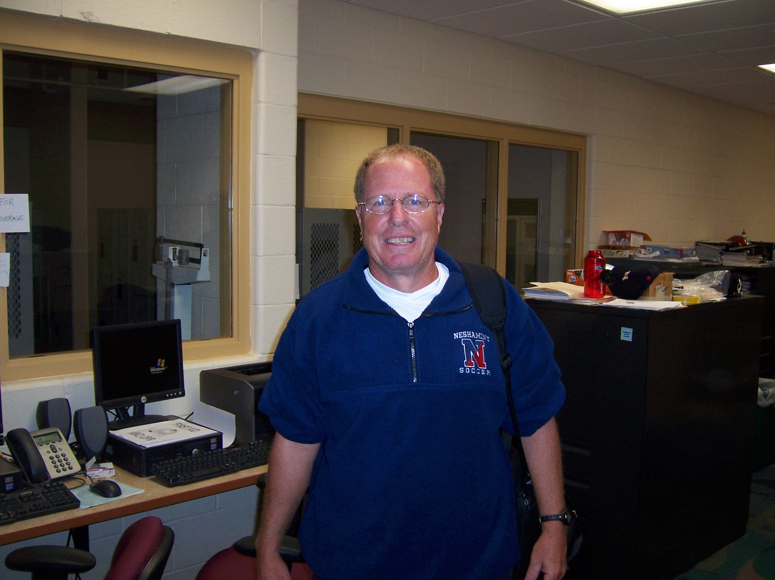
MR. REICE

Slide 9
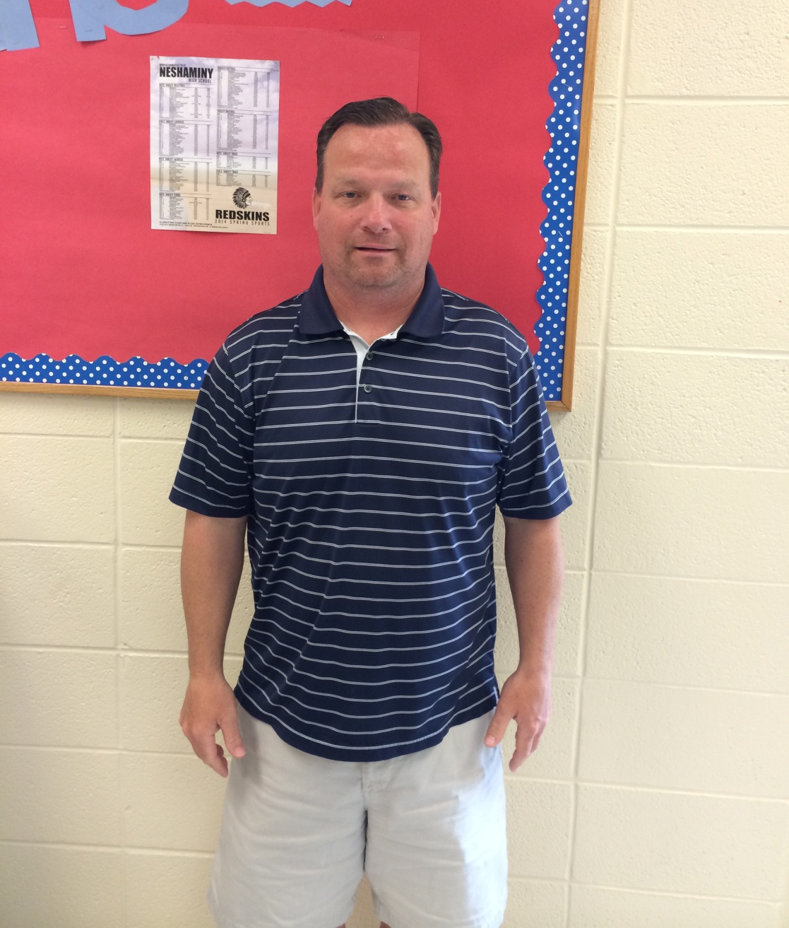
MR. SMITH

Slide 10
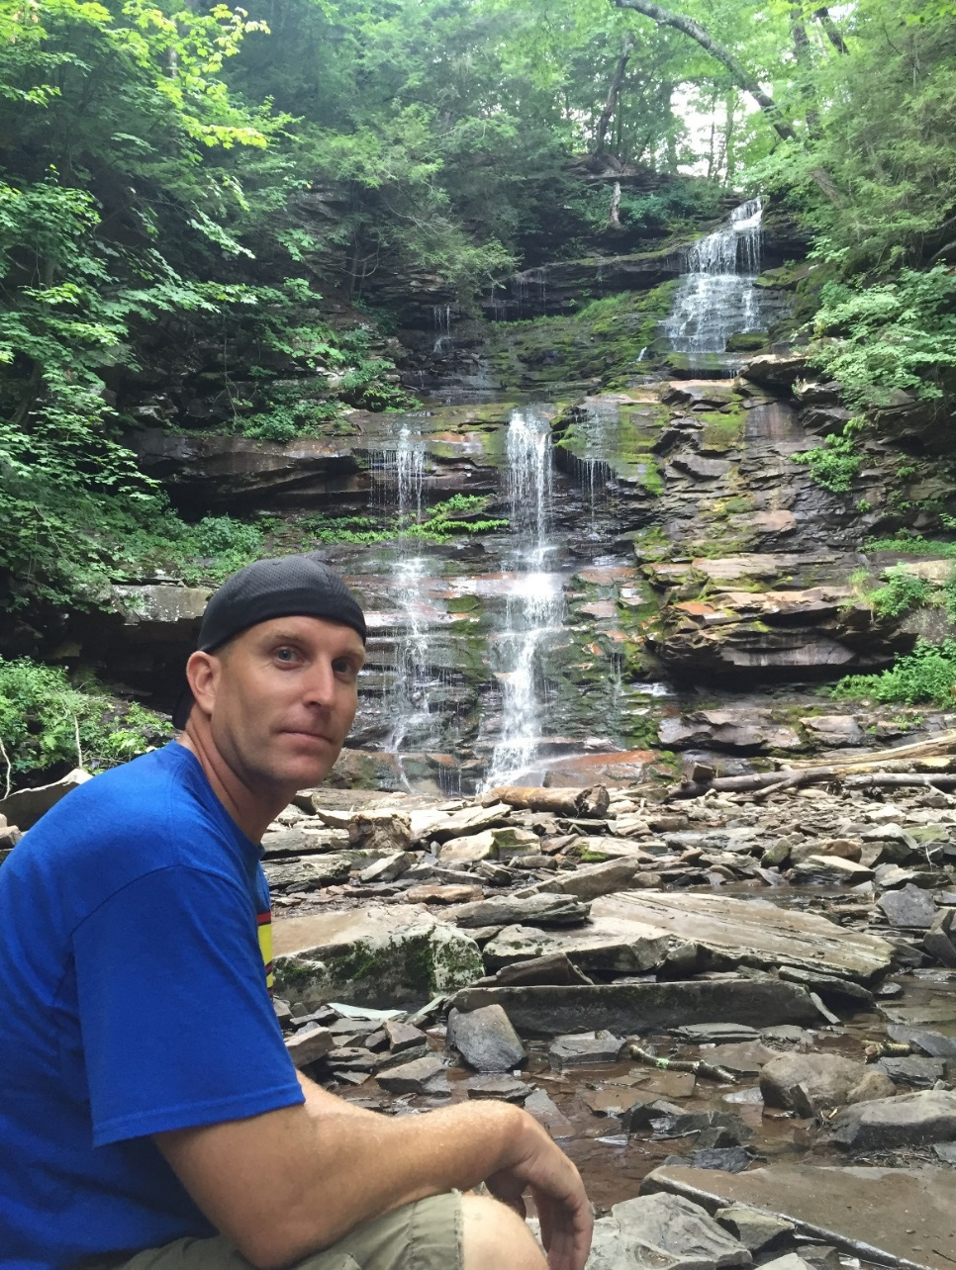
MR. TENAGLIA

Slide 11
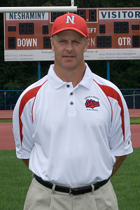
MR. WEIDENBAUGH

Slide 12
NEW
PE CURRICULUM
FRESHMAN: Follow PE Preview Unit
11/12: Select PE activities for the
MARKING PERIOD
FITNESS FRIDAYS!

Slide 13
SELECTIVE PE
MARKING PERIOD THEMES:
  Team Games, Racquet Sports, Fitness, Challenge, ETC
Choose once a marking period
Stay with that teacher for the marking period.
Based off of your survey results!

Slide 14
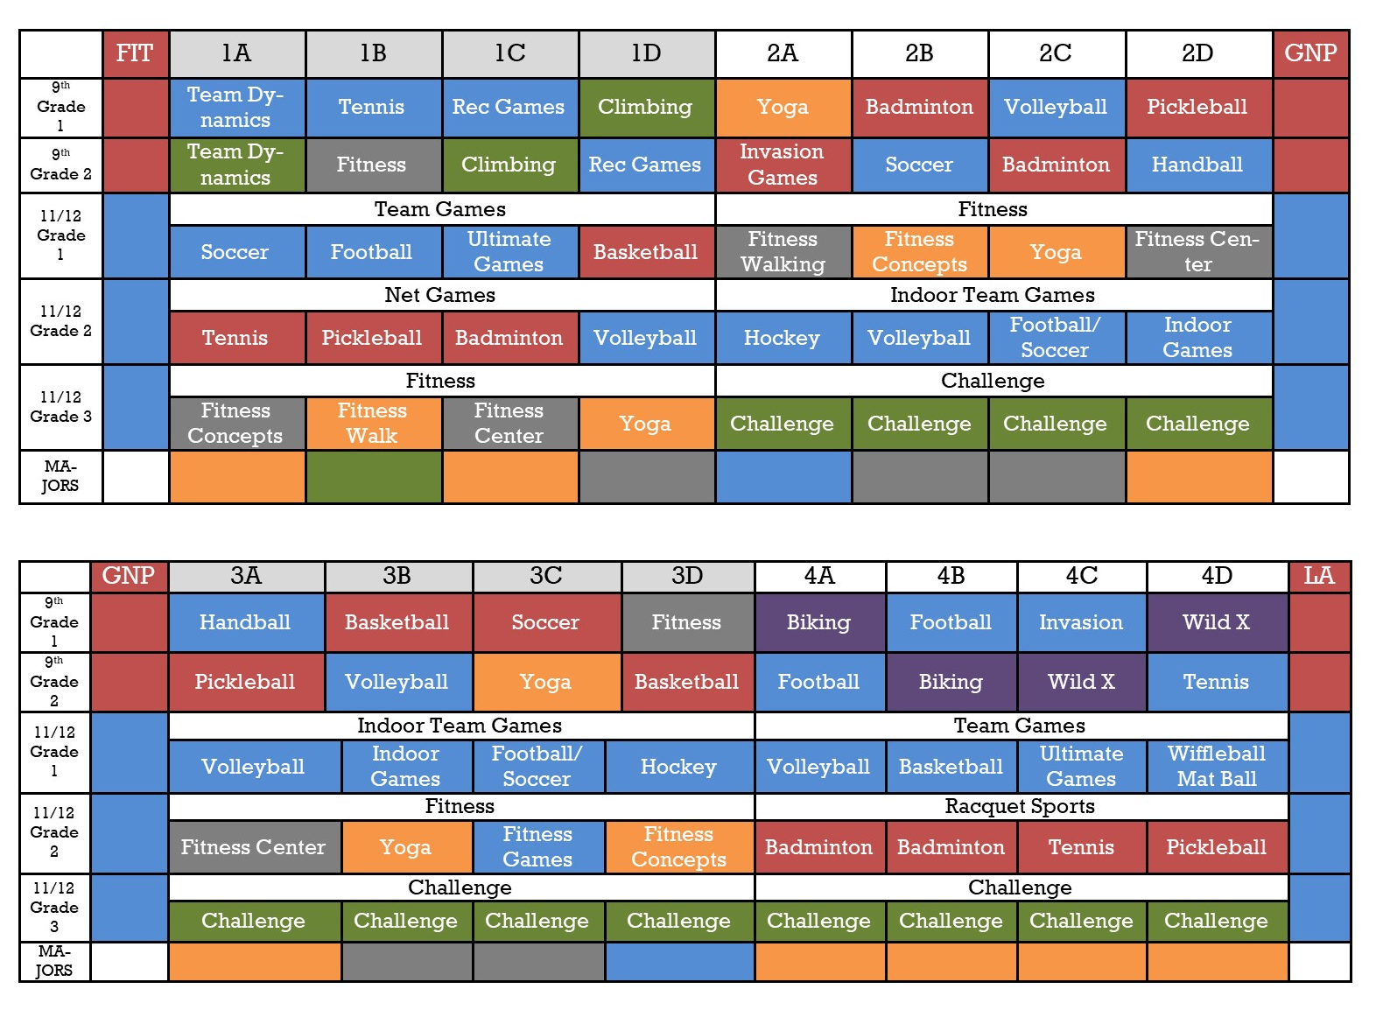
PHYSICAL EDUCATION ACTIVITY GRID 2019 – 2020

Slide 15
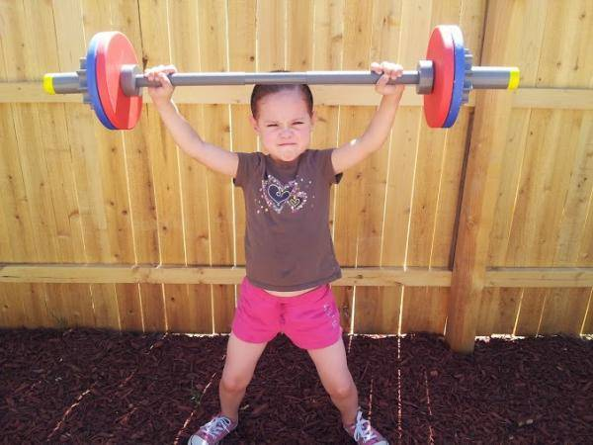
FITNESS FRIDAYS
1st Thursday/Friday of every month = FITNESS FRIDAY
Health Related Components of Fitness
Skill Related Components of Fitness

Slide 16

YOUR GRADE
Active Involvement in Learning and Class Activities
Safe Practices and Appropriate Clothing
Working with Others
Strategies and Tactical Concepts
Skill Improvement
Class Assignments and Assessments
Fitness Friday

Slide 17
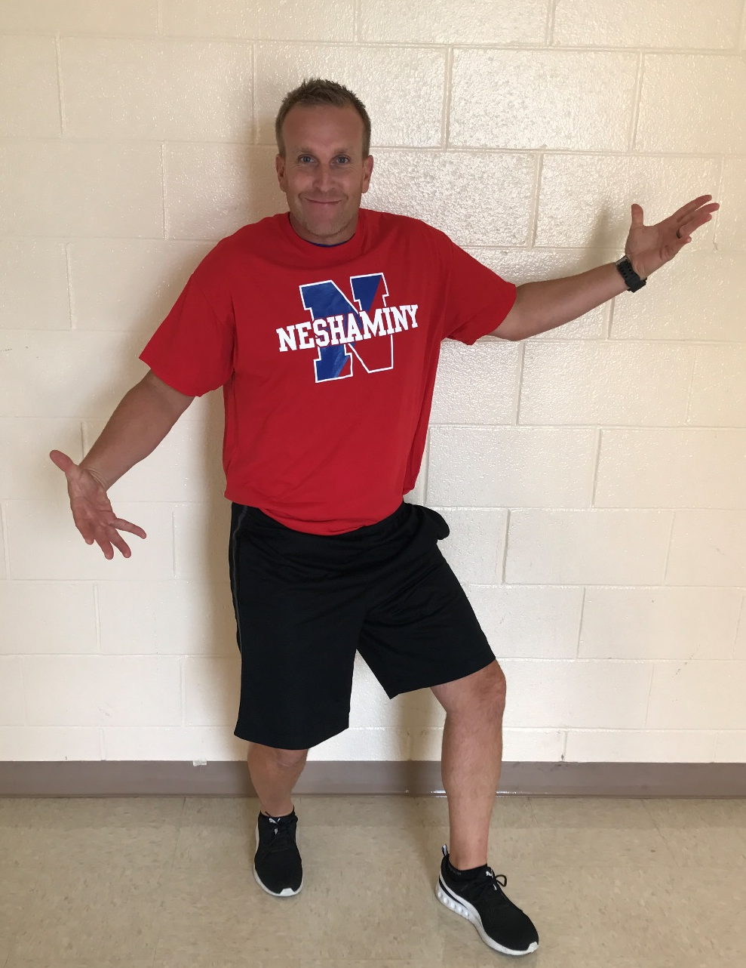

10 points
-SNEAKERS
-Athletic Bottoms
- T-SHIRT / Sweatshirt
Points are contingent on participation

Slide 18
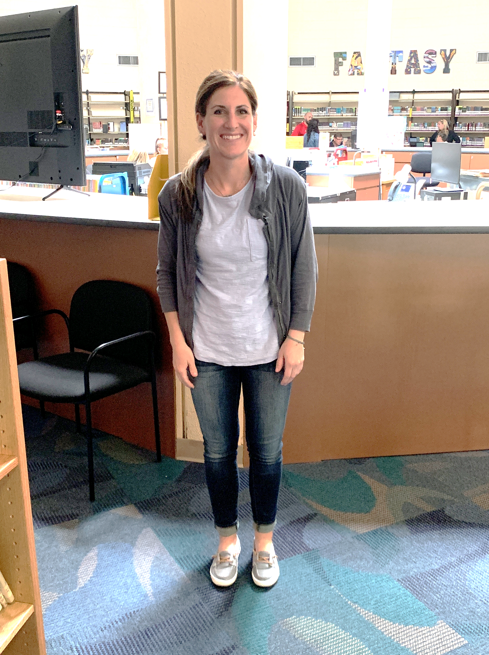
7 points
-Jeans
-SPERRY’S
+
PARTICIPATION
IN REGULAR
ACTIVITIES

Slide 19
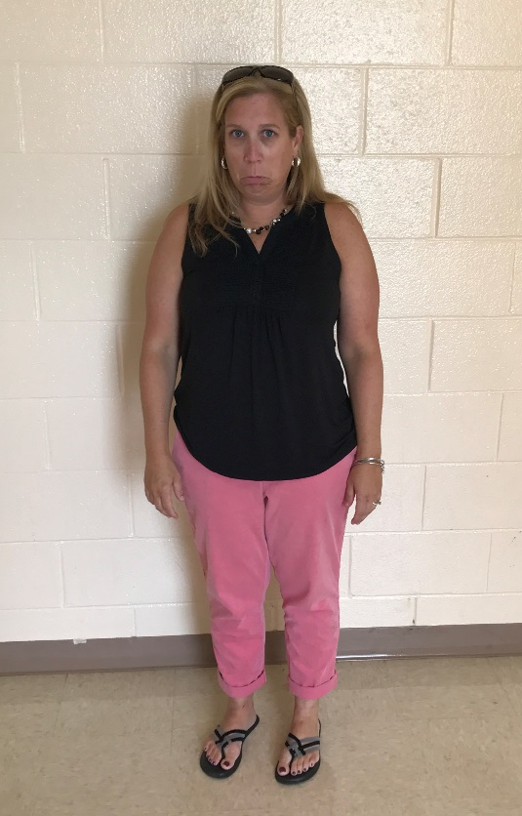
UNPREPARED!
5 points
-Not appropriate/
safe footwear
-Non Athletic Attire
If…
YOU WALK!

Slide 20

UNAPPROVED
Jeggings
Flip Flops
Jeans
Uggs
Sperrys
“I have a game today… I’m can’t tie this tie again…”

Slide 21
PE PROCEDURES
BEGINNING CLASS
  All students will report to GYM 3 to meet teacher.
  You have 5 Minutes after bell rings to get there!
      You WILL BE MARKED LATE.
  Locker Room doors locked during class time.

Slide 22
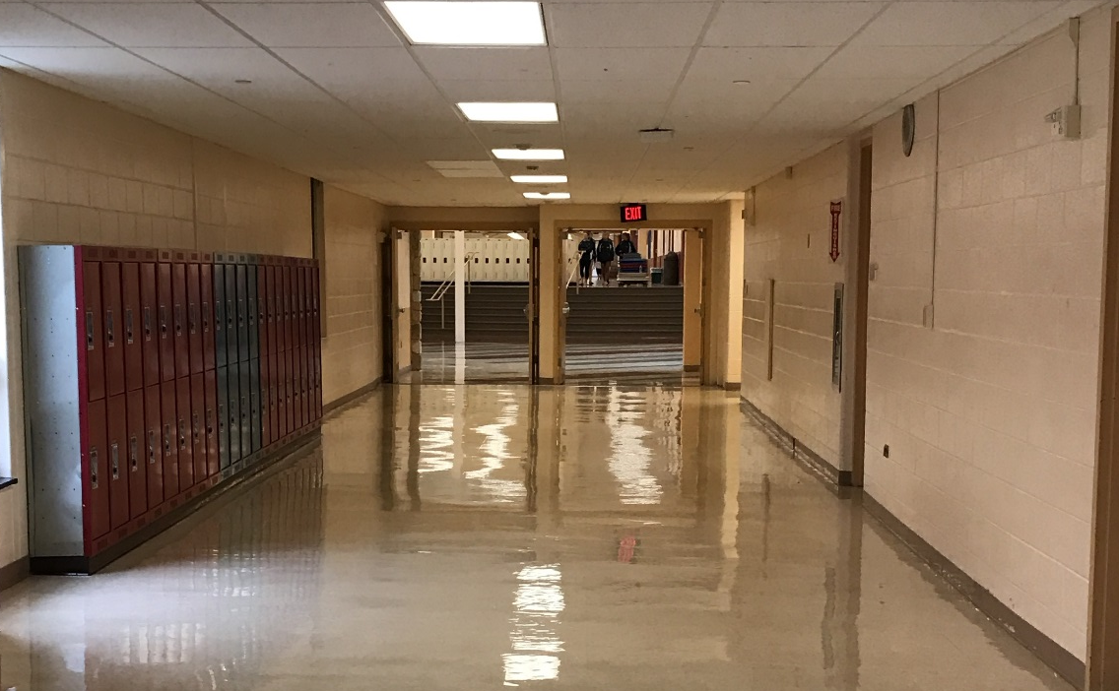

END OF CLASS
Gather your belonging and you may head into J-hall until the bell rings.

Slide 23

LOCKS
  Provide own and use it!
  Lock all valuables, school not responsible
  People WILL steal unlocked items

Slide 24
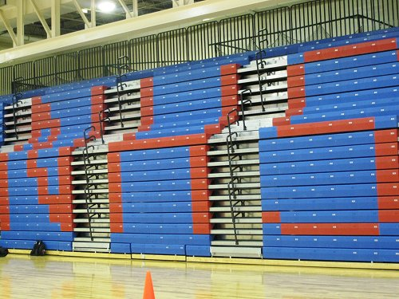

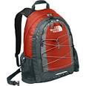
BOOK BAGS AND PERSONAL ITEMS
MUST REMAIN IN THE
LOCKER ROOM
AT ALL TIMES!

Slide 25

BACKPACKS
1st Offense: Warning
2nd Offense: Call Home
3rd Offense & Beyond: Write-Up for Insubordination

Slide 26

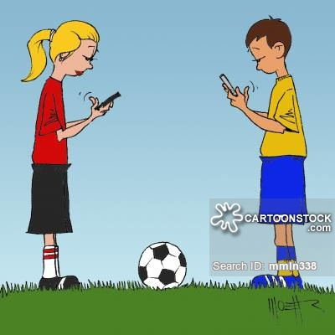
ENOUGH SAID

Slide 27

ABSENCES
You will be given 2 ABSENCES.
After 2, you will need to MAKE-UP your absence.
  EXAMPLE of an ABSENCE:
    Out of School – Sick
    Guidance Appointment
    Nurse
    Parent Note to not participate

Slide 28
MAKE-UPS
You have a two week window period to do make ups.
Make-ups will be after school. Schedule is posted on the PE website.
Time: 2:35-5:00. Can only make 4 up on one day.
This will be treated as a regular class.
  YOU WILL BE GRADED!

Slide 29
MEDICAL NOTES
YOU MUST HAVE A NOTE to be medically excused.
  Note must say what you can and cannot do.
SHORT TERM – Less than 2 weeks
  Made up like absences.
  Earn points through teacher alternate activity (special situations).
LONG TERM - More than 2 weeks
  Will be placed in a study hall.
  Scheduled through their guidance counselor.

Slide 30
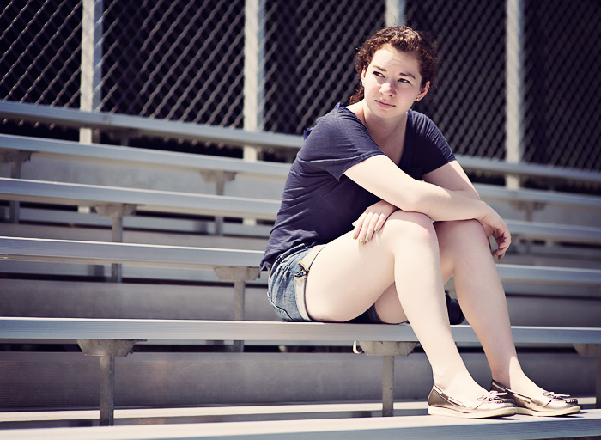
NO OPT-OUT
WE OPT-IN!

Slide 31
Be ACTIVE!
Physical Education Opt-Out
  THIS IS NOT AN OPTION.
    You cannot “take a zero”.
    You WILL be ACTIVE EVERY CLASS PERIOD.
There will be NO EATING in ANY PHYSICAL EDUCATION AREA.

Slide 32

GET MOVING!

